Slide 1
So, Neither
PREPIŠI PPT V ZVEZEK IN REŠI VAJE. POMAGAJ SI Z UČBENIKOM.

Slide 2
SO
We use so to mean “too” or “also”
Alice: I work in a hospital.
Paul: So do I.
NEITHER
Neither is used to show agreement with negative statements or ideas
Alice: I don’t like coffee.
Paul: Neither do I.

Slide 3
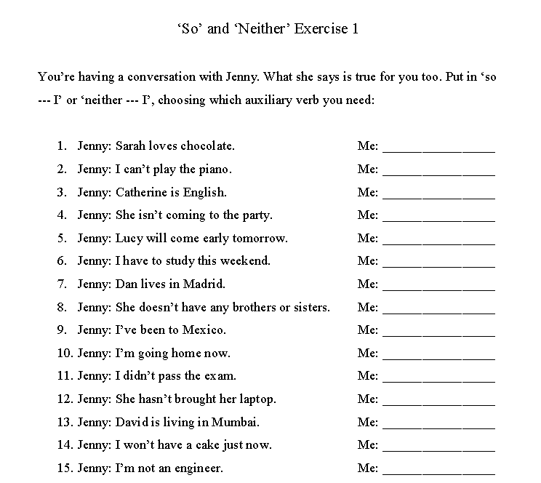

Slide 4
