Slide 1
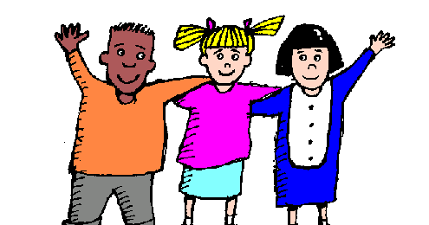
COMPARISON OF ADJECTIVES

Slide 2
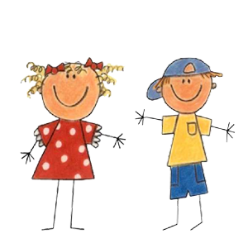
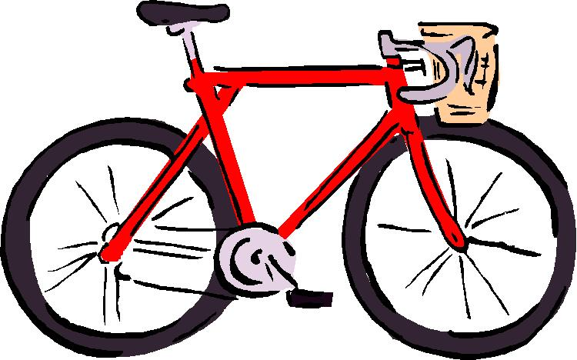
1. stopnja
AS…..AS
NOT AS….AS
Aljoša is as tall as Nina.
A bike is not as expensive as a car.
Primerjamo dve enaki/podobni osebi/stvari

Slide 3
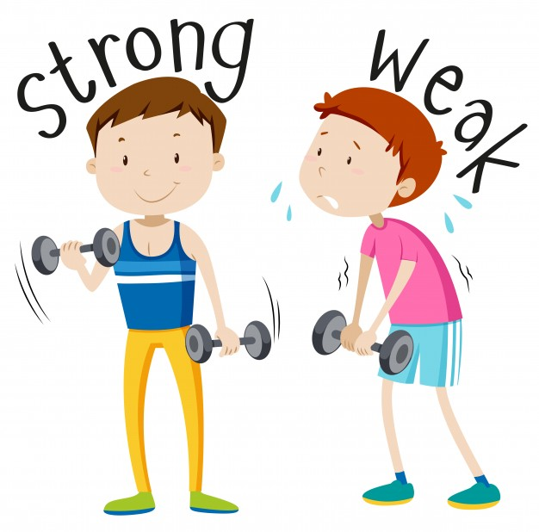
2. Stopnja (Comparative)
Primerjamo dve osebi/stvari, ki nista enaki
THAN
OF THE TWO

Slide 4
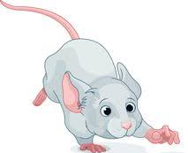
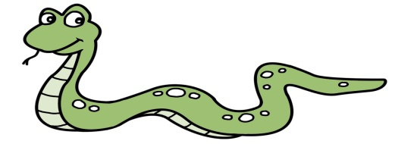
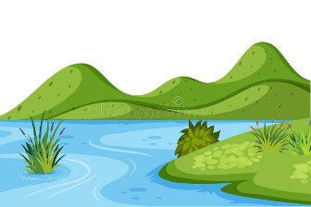
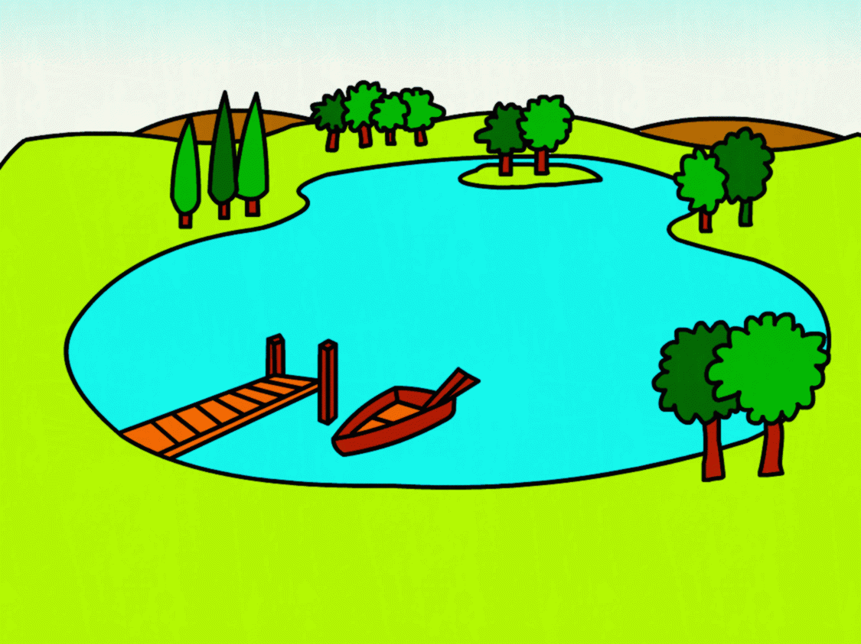
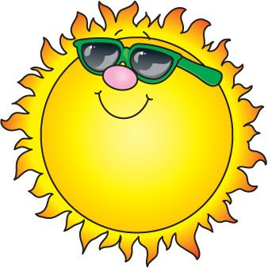
Short Adjectives
A mouse is shorter than a snake.
Lake Ontario is wider than Šmartinsko lake.
Today is sunnier than yesterday.
An elephant is bigger than a lion..
-ER

Slide 5
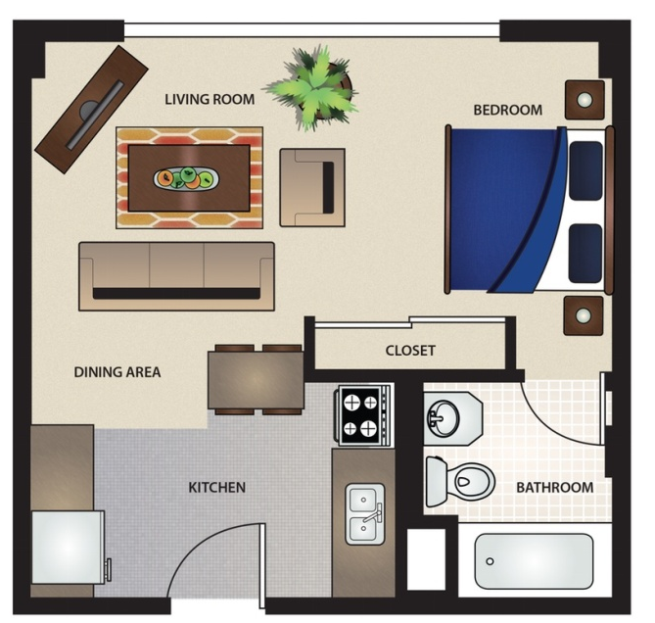
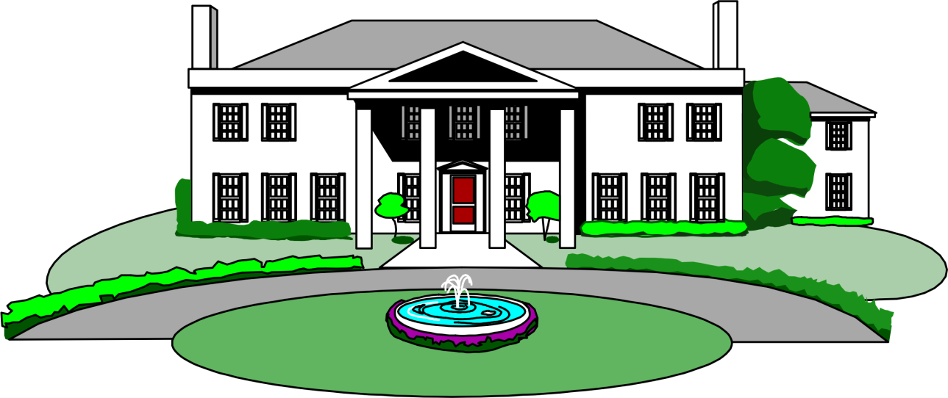
Long Adjectives
2 zloga ali več
MORE
A villa is more expensive than a little flat.

Slide 6
3. Stopnja (Superlative)
OF ALL (of the three,…)
IN THE WORLD (the class, the group,…)
Primerjamo 3 ali več stvari/oseb

Slide 7
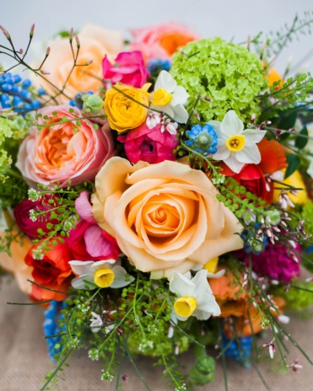
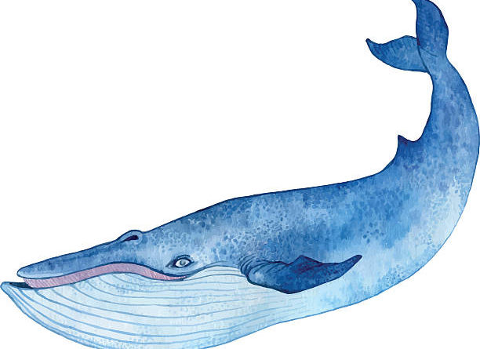
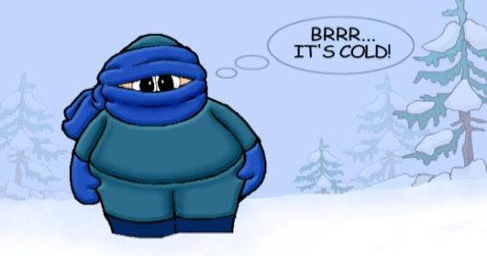
Short Adjectives
the -EST
Rose is the loveliest flower in this picture.
A blue whale is the largest animal of all.
January is the coldest month of the year.

Slide 8
Long Adjectives
THE MOST
Humans are the most dangerous beings on Earth.
The most boring school subject on my timetable is English.

Slide 9
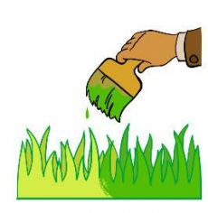
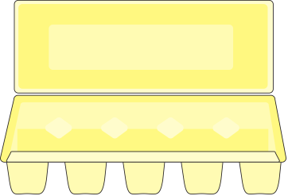
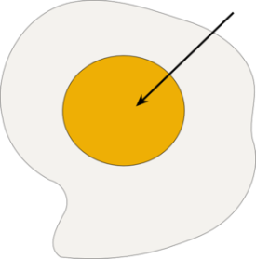
COLOUR Adjectives
Can follow both rules:
The grass is always greener on the other side.
Or:
An egg yolk is more yellow than this box.
It’s always better to compare colours with LIGHT (lighter blue) and DARK (darker brown) - shades!

Slide 10
